Slide 1







Efficient Secure Aggregation for Privacy-Preserving Federated Machine Learning
Rouzbeh Behnia¹, Arman Riasi², Reza Ebrahimi¹, Sherman S. M. Chow³, Balaji Padmanabhan⁴, Thang Hoang²
¹ University of South Florida
² Virginia Tech
³ The Chinese University of Hong Kong
⁴ University of Maryland, College Park
The Annual Computer Security Applications Conference (ACSAC)

Slide 2


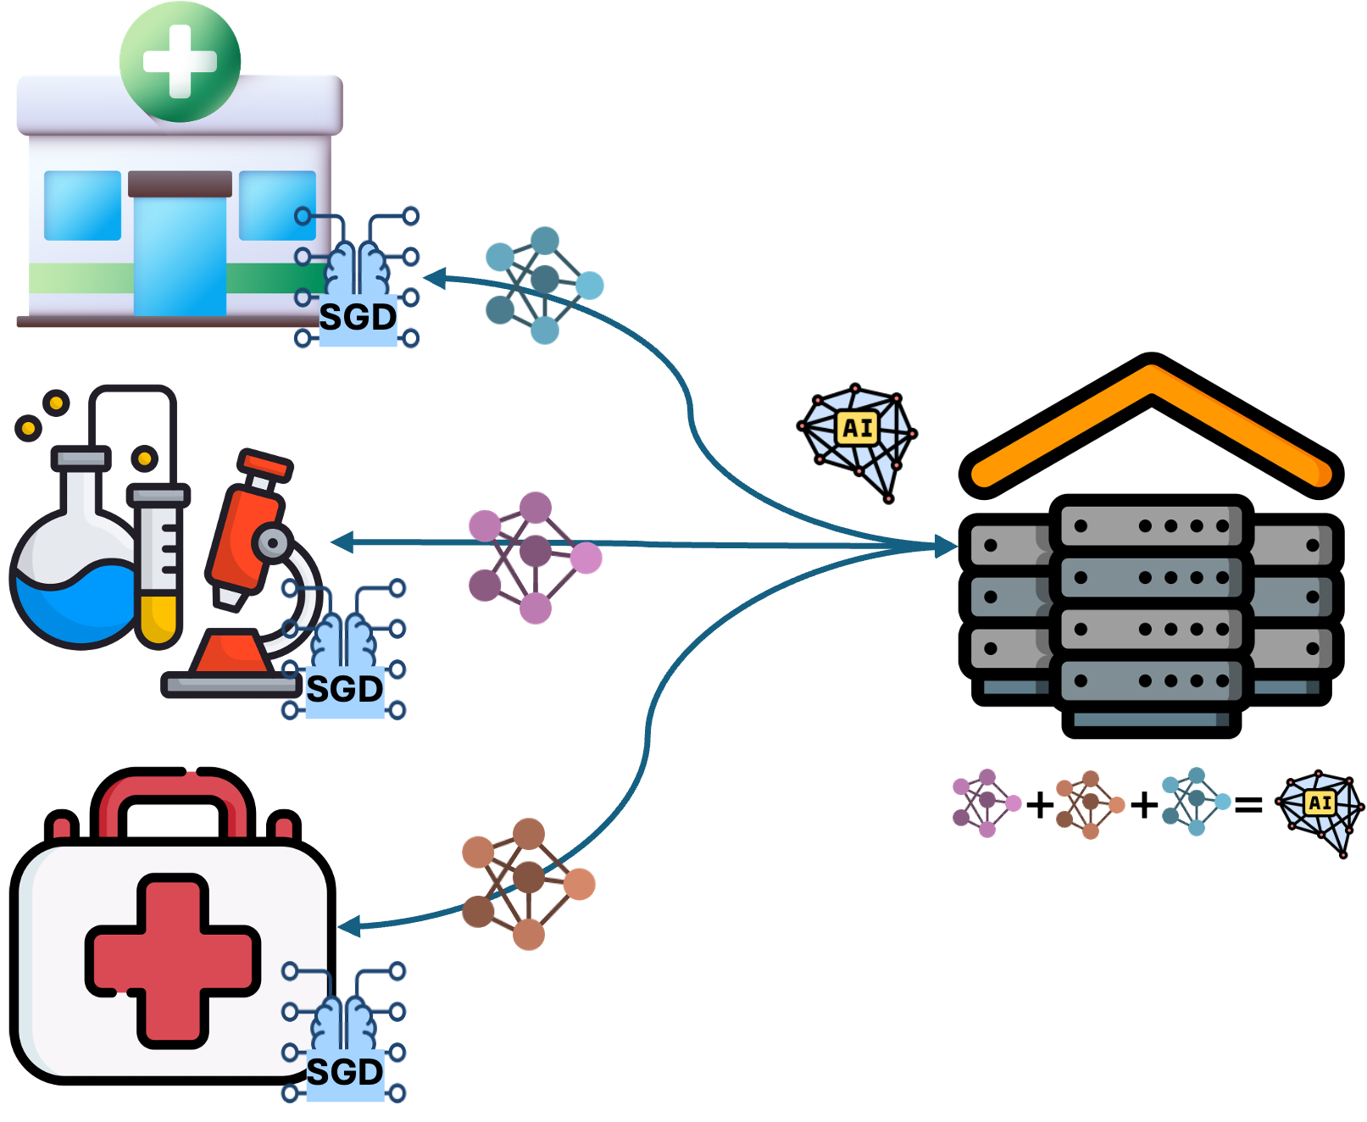
Federated Learning
Federated Learning (FL) enables the distributed training of an AI model.
Contributes to privacy by preserving the locality of the data (HIPPA)
Users only share their local gradients, trained on their local dataset, with a central server
The training often continuous for multiple iterations until the global model, computed by the server, converges

Slide 3
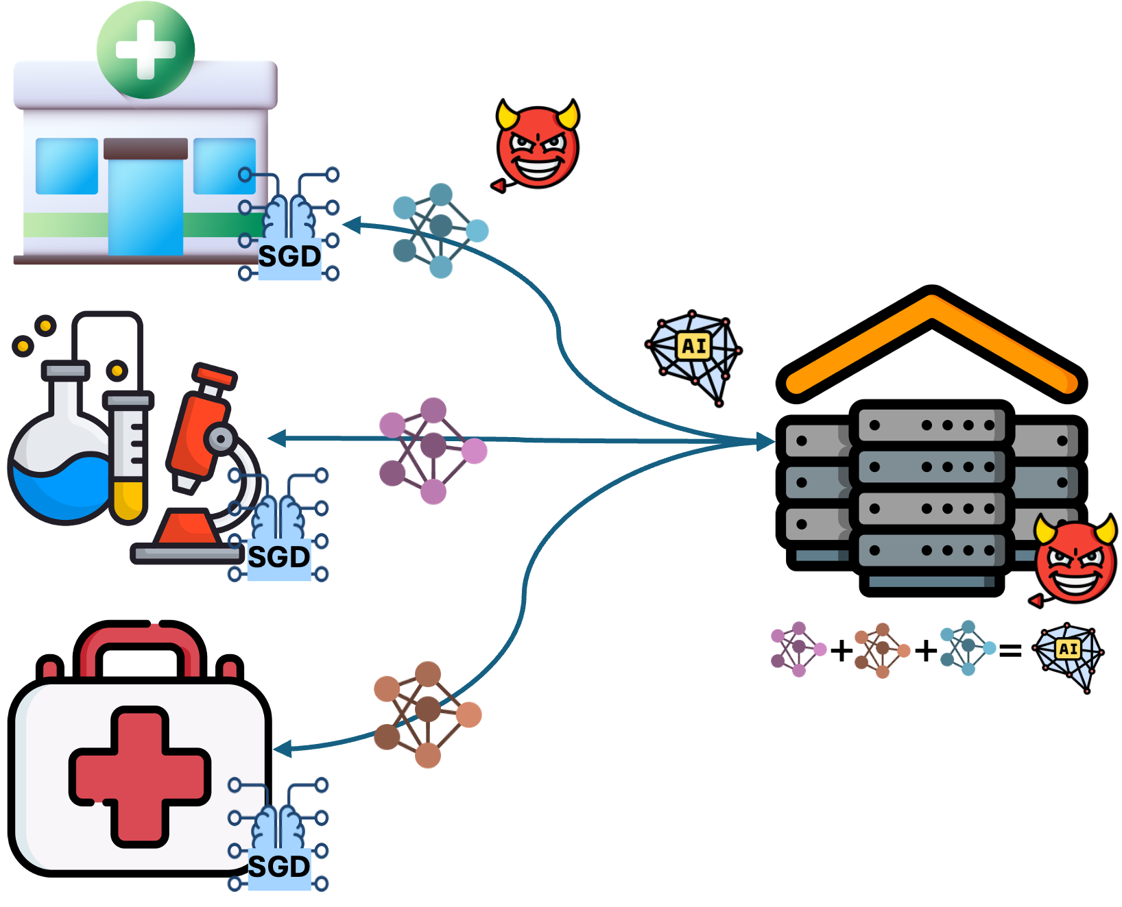
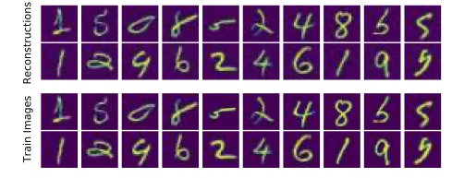
Data Extraction Attacks
Emerging data reconstruction attack target FL systems:
Local gradients, shared by the server, can inadvertently expose sensitive information about user data
Server only requires the element-wise weighted average of the gradient vectors
We can utilize secure aggregation protocols to compute the sum of the gradients
Loo et al. (ICLR 2024)

Slide 4







Secure Aggregation Protocols
Cryptographic mechanisms protect gradient privacy
Each user mask their gradients with pseudorandom terms symmetrically
These are shared between user pairs and then secret-shared among other users
Existing methods incur high communication and computation overhead
Might not be resilient to user dropouts
For large scale FL systems, user dropouts might affect the model convergence

Slide 5
Secure Aggregation Protocols Challenges
Bonawitz et al. (CCS 2017) identified THREE core challenges:
Security against malicious attacks in a server-mediated environment
Minimum setup complexity for users with constrained devices and unreliable connections
High resilience to user dropouts

Slide 6
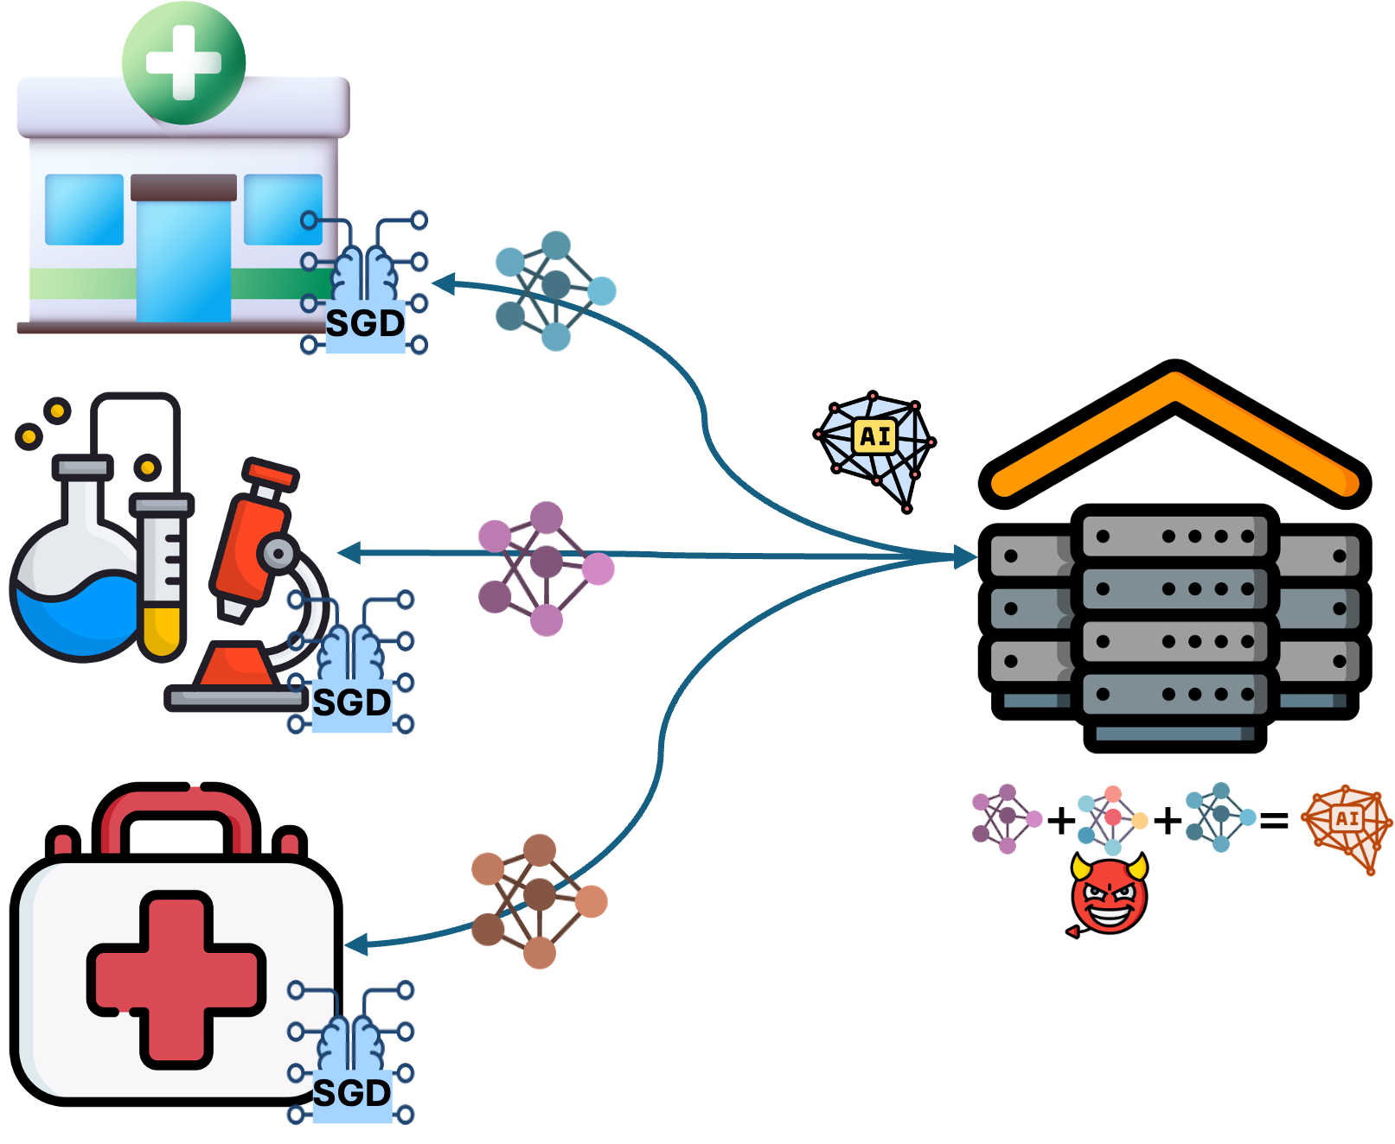
Existing Works
Two main building blocks:
Multi-party computation (MPC):
Require multiple communication rounds
Often can tolerate a small fraction of user dropouts
Require enough shares to reconstruct the secret of dropout users
Homomorphic Encryption (HE):
Communication efficient
Can incur huge computational overhead (for large models)
Most existing works assume the aggregation server computes the model honestly
Errors and malicious behaviors go undetected

Slide 7
e-SeaFL: High-level Idea
Existing secure aggregation protocol assume a subset of the users to be honest
We relax and extend this idea to a set of assisting nodes
The privacy guarantees of e-SeaFL holds as long as ONE assisting node is honest.
Each assisting node is sharing a secret seed with a user and aids the server in computing the final model
e-SeaFL utilizes authenticated homomorphic vector commitment to provide proof of honest aggregation
Model integrity can be verified by all the users via a proof provided by the server

Slide 8
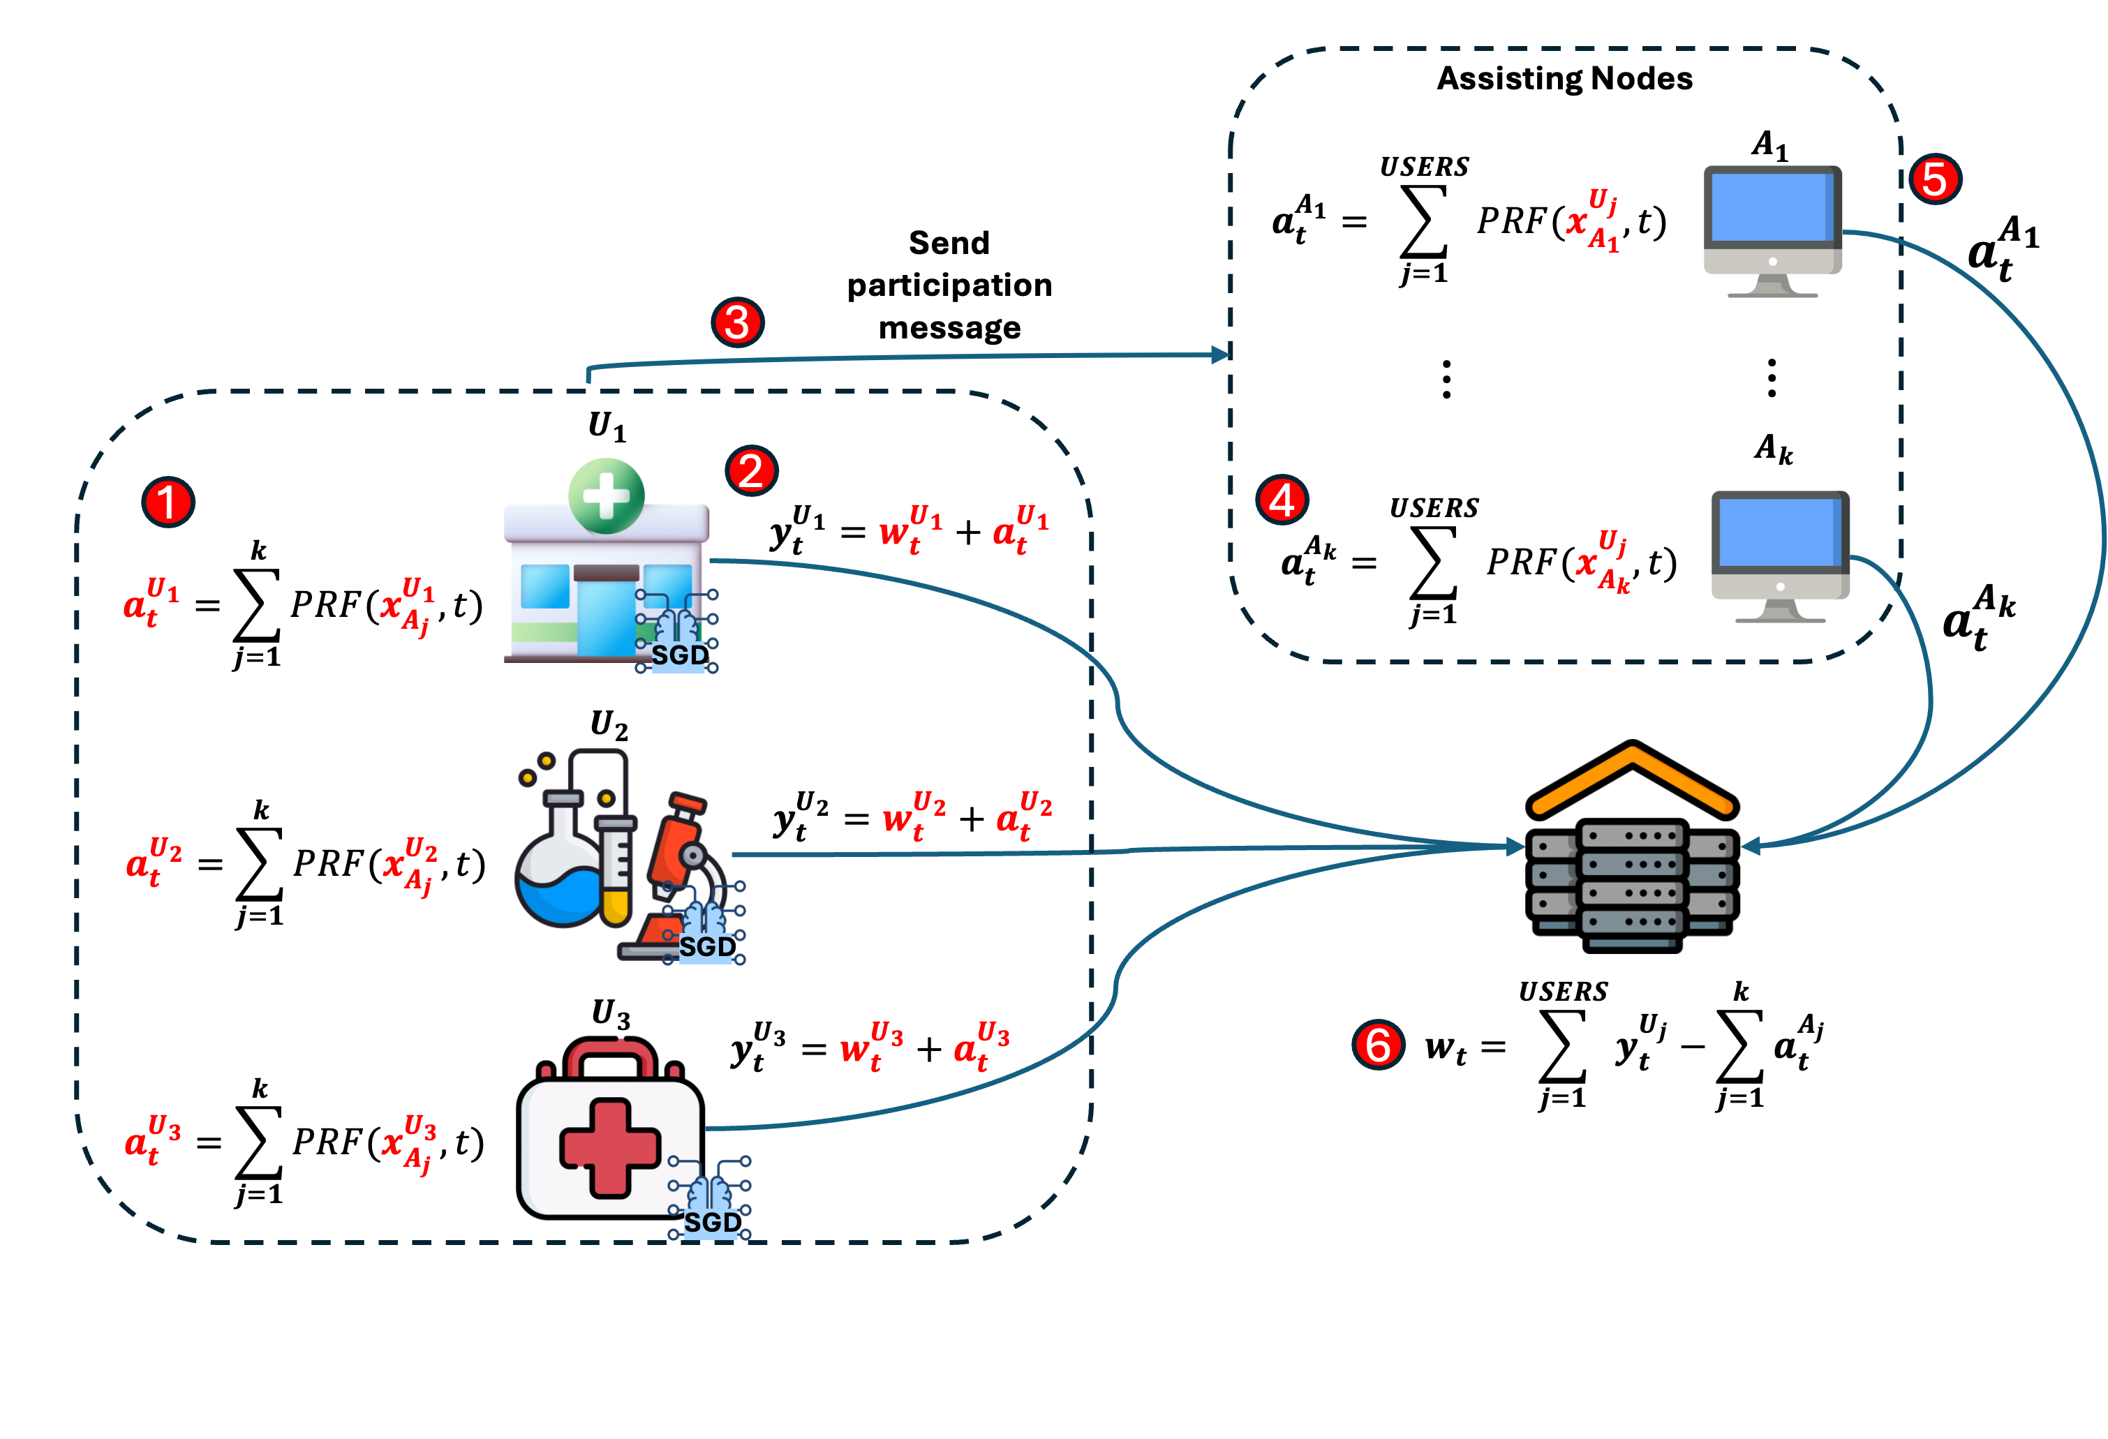
e-SeaFL: High-level Idea (2)

Slide 9
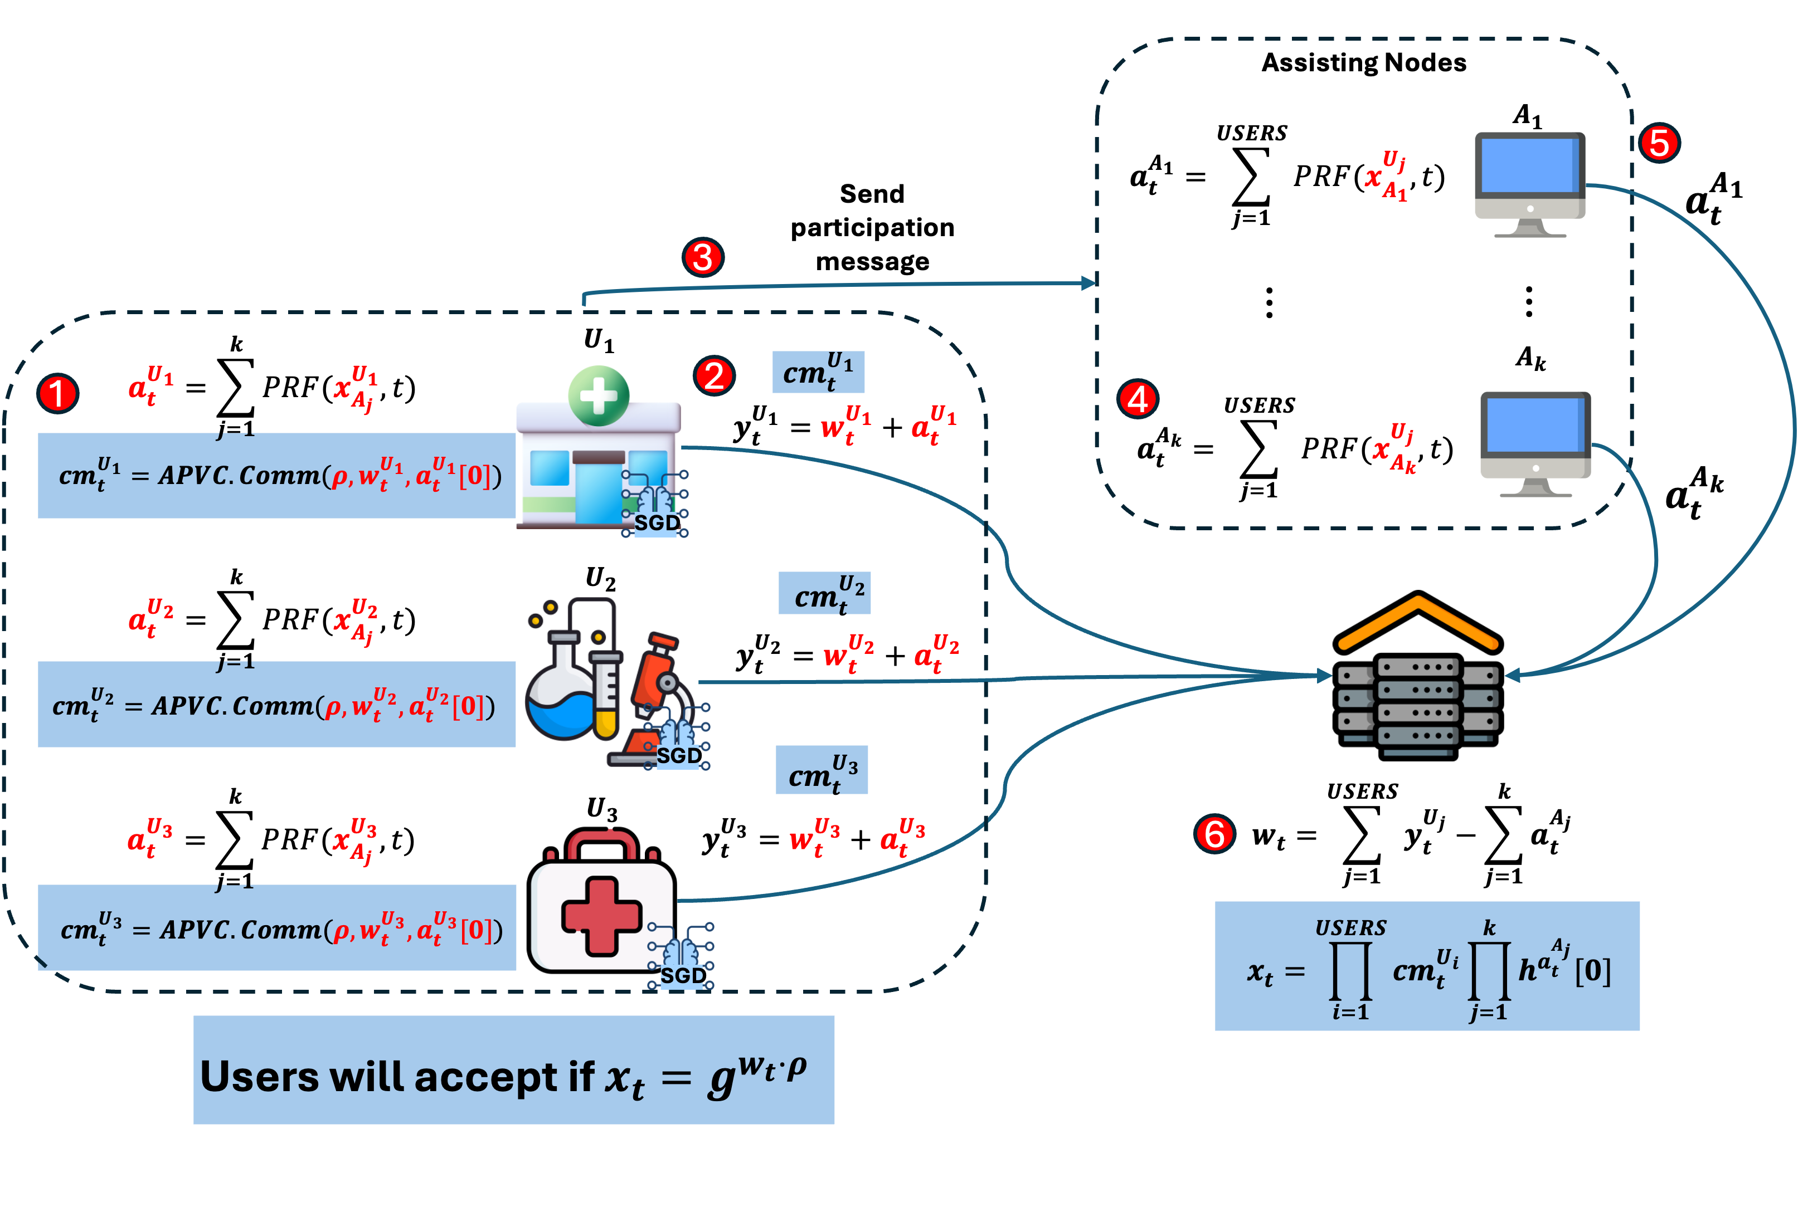
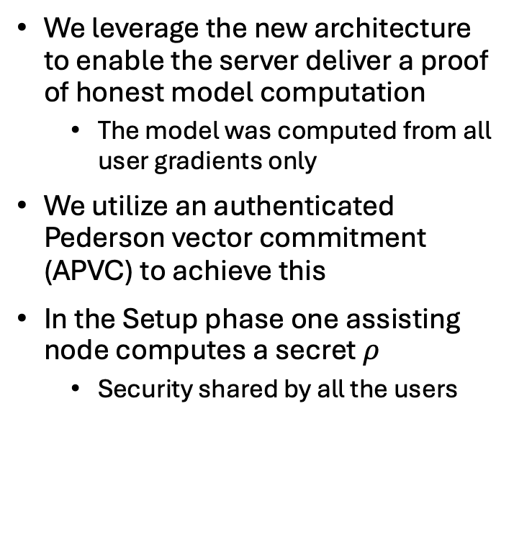
E-SeaFL: Proof of Honest Aggregation
We leverage the new architecture to enable the server deliver a proof of honest model computation
The model was computed from all user gradients only
We utilize an authenticated Pederson vector commitment (APVC) to achieve this
In the Setup phase one assisting node computes a secret $ρ$
Security shared by all the users

Slide 10

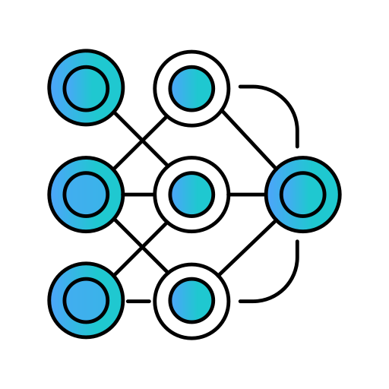


Evaluation: Setup and Implementation
Setup:
Evaluation was in in both semi-honest (SH) and Malicious (MS) setting
We considered a range of 200 to 1,000
Three assisting nodes
Weight vector of 16,000 gradients
Competitors:
MicroSecAgg (PoPETS 2024)
Flamingo (IEEE S&P 2023)
Implementation
1,500 line of code
Libraries: Coincurve, OpenSSL, secp256k1

Slide 11
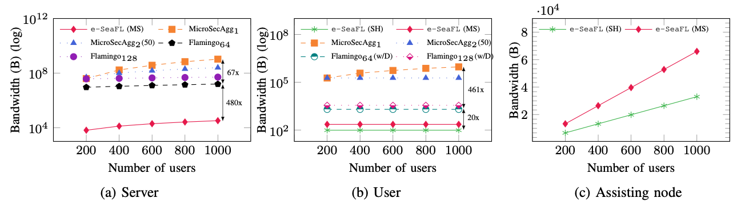
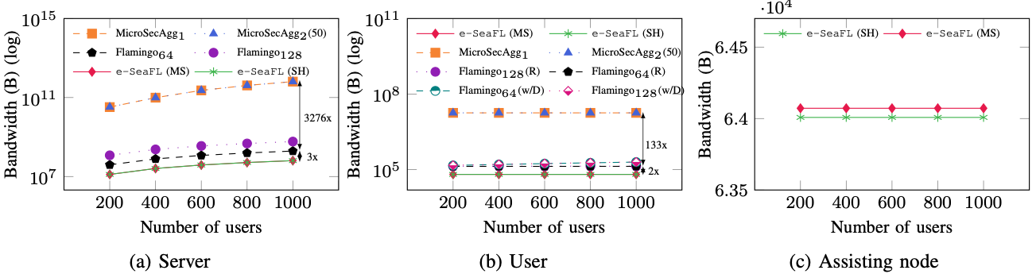
Evaluation: Communication
Setup:
Aggregate:

Slide 12
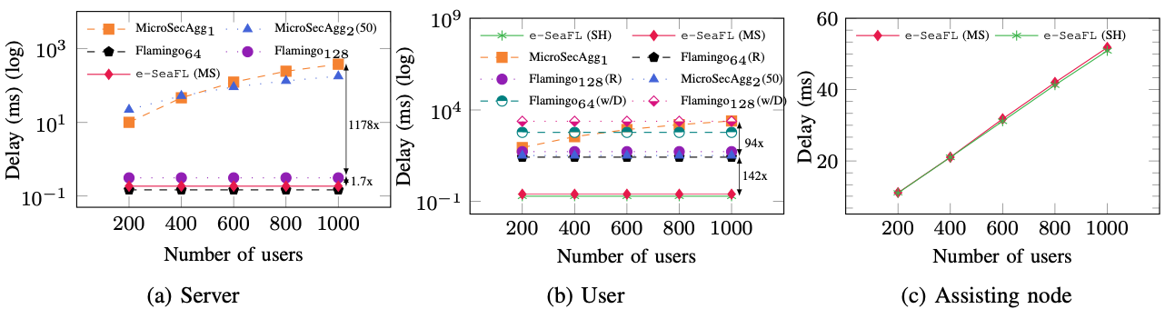
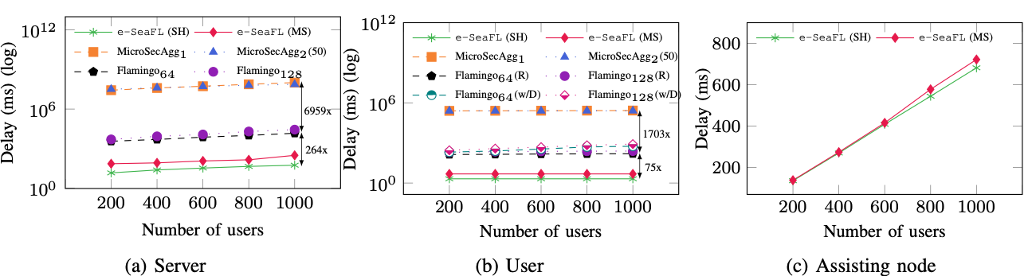
Evaluation: Computation
Setup:
Aggregate:

Slide 13
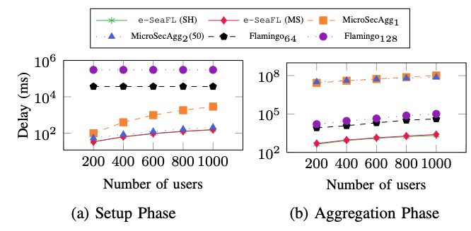

Evaluation: Overall Computation Overhead
In aggregation phase, e-SeaFL is up to 65,000$×$ and 41$×$ faster than MicroSecAgg and Flamingo, respectively

Slide 14
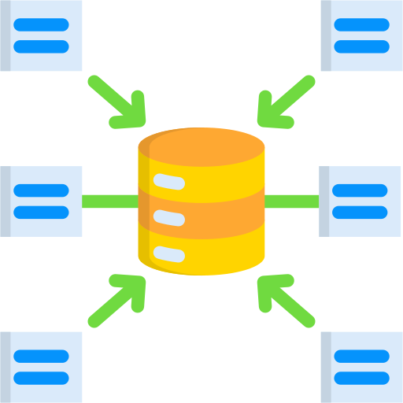

Conclusion
e-SeaFL:
Only takes one communication round in aggregation phase
Highly resilient to user dropout
Provide proof of honest aggregation
One can assume set of dynamic and rotating assisting nodes

Slide 15
Thank you
Q&A
Artifact available: https://github.com/vt-asaplab/e-SeaFL

